Slide 1
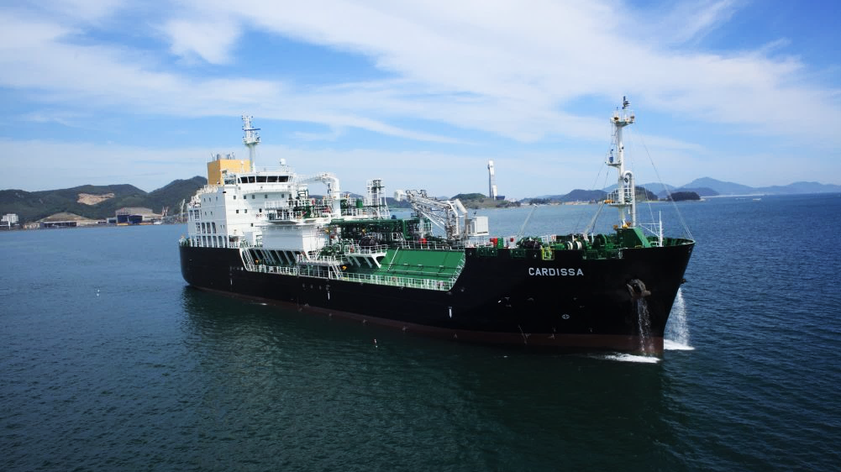


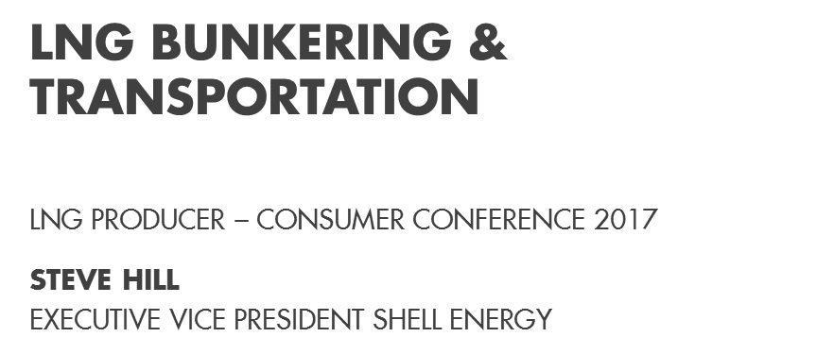

Slide 2
DEFINITIONS & CAUTIONARY NOTE
Reserves: Our use of the term “reserves” in this presentation means SEC proved oil and gas reserves.
Resources: Our use of the term “resources” in this presentation includes quantities of oil and gas not yet classified as SEC proved oil and gas reserves. Resources are consistent with the Society of Petroleum Engineers (SPE) 2P + 2C definitions.
Discovered and prospective resources: Our use of the term “discovered and prospective resources” are consistent with SPE 2P + 2C + 2U definitions.
Organic: Our use of the term Organic includes SEC proved oil and gas reserves excluding changes resulting from acquisitions, divestments and year-average pricing impact.
Shales: Our use of the term ‘shales’ refers to tight, shale and coal bed methane oil and gas acreage.
Underlying operating cost is defined as operating cost less identified items. A reconciliation can be found in the quarterly results announcement.
The companies in which Royal Dutch Shell plc directly and indirectly owns investments are separate legal entities. In this release “Shell”, “Shell group” and “Royal Dutch Shell” are sometimes used for convenience where references are made to Royal Dutch Shell plc and its subsidiaries in general. Likewise, the words “we”, “us” and “our” are also used to refer to subsidiaries in general or to those who work for them. These expressions are also used where no useful purpose is served by identifying the particular company or companies. ‘‘Subsidiaries’’, “Shell subsidiaries” and “Shell companies” as used in this release refer to companies over which Royal Dutch Shell plc either directly or indirectly has control. Entities and unincorporated arrangements over which Shell has joint control are generally referred to as “joint ventures” and “joint operations” respectively. Entities over which Shell has significant influence but neither control nor joint control are referred to as “associates”. The term “Shell interest” is used for convenience to indicate the direct and/or indirect ownership interest held by Shell in a venture, partnership or company, after exclusion of all third-party interest.
This release contains forward-looking statements concerning the financial condition, results of operations and businesses of Royal Dutch Shell. All statements other than statements of historical fact are, or may be deemed to be, forward-looking statements. Forward-looking statements are statements of future expectations that are based on management’s current expectations and assumptions and involve known and unknown risks and uncertainties that could cause actual results, performance or events to differ materially from those expressed or implied in these statements. Forward-looking statements include, among other things, statements concerning the potential exposure of Royal Dutch Shell to market risks and statements expressing management’s expectations, beliefs, estimates, forecasts, projections and assumptions. These forward-looking statements are identified by their use of terms and phrases such as ‘‘anticipate’’, ‘‘believe’’, ‘‘could’’, ‘‘estimate’’, ‘‘expect’’, ‘‘goals’’, ‘‘intend’’, ‘‘may’’, ‘‘objectives’’, ‘‘outlook’’, ‘‘plan’’, ‘‘probably’’, ‘‘project’’, ‘‘risks’’, “schedule”, ‘‘seek’’, ‘‘should’’, ‘‘target’’, ‘‘will’’ and similar terms and phrases. There are a number of factors that could affect the future operations of Royal Dutch Shell and could cause those results to differ materially from those expressed in the forward-looking statements included in this release, including (without limitation): (a) price fluctuations in crude oil and natural gas; (b) changes in demand for Shell’s products; (c) currency fluctuations; (d) drilling and production results; (e) reserves estimates; (f) loss of market share and industry competition; (g) environmental and physical risks; (h) risks associated with the identification of suitable potential acquisition properties and targets, and successful negotiation and completion of such transactions; (i) the risk of doing business in developing countries and countries subject to international sanctions; (j) legislative, fiscal and regulatory developments including regulatory measures addressing climate change; (k) economic and financial market conditions in various countries and regions; (l) political risks, including the risks of expropriation and renegotiation of the terms of contracts with governmental entities, delays or advancements in the approval of projects and delays in the reimbursement for shared costs; and (m) changes in trading conditions. There can be no assurance that future dividend payments will match or exceed previous dividend payments. All forward-looking statements contained in this release are expressly qualified in their entirety by the cautionary statements contained or referred to in this section. Readers should not place undue reliance on forward-looking statements. Additional risk factors that may affect future results are contained in Royal Dutch Shell’s 20-F for the year ended December 31, 2015 (available at www.shell.com/investor and www.sec.gov). These risk factors also expressly qualify all forward looking statements contained in this release and should be considered by the reader. Each forward-looking statement speaks only as of the date of this release, October 18, 2017. Neither Royal Dutch Shell plc nor any of its subsidiaries undertake any obligation to publicly update or revise any forward-looking statement as a result of new information, future events or other information. In light of these risks, results could differ materially from those stated, implied or inferred from the forward-looking statements contained in this release.
With respect to operating costs synergies indicated, such savings and efficiencies in procurement spend include economies of scale, specification standardisation and operating efficiencies across operating, capital and raw material cost areas.
We may have used certain terms, such as resources, in this release that United States Securities and Exchange Commission (SEC) strictly prohibits us from including in our filings with the SEC. U.S. Investors are urged to consider closely the disclosure in our Form 20-F, File No 1-32575, available on the SEC website www.sec.gov.

Slide 3
THE ENERGY CHALLENGE – MORE ENERGY, FEWER EMISSIONS
There is more demand for energy globally as the world’s population and living standards increase
Growing population
Global population is expected to increase from around 7 billion today to nearly 10 billion by 2050, with 67% living in cities.
Rising demand
Global energy demand will likely be almost 60% higher in 2060 than today, with 2 billion vehicles on the road (900 million today).
Ongoing supply
Renewable energy could triple by 2050, but we will still need large amounts of oil and gas to provide the full range of energy products that the world needs.
Mitigating
climate change
Net-zero emissions is
a potentially achievable
societal ambition.

Slide 4
DIFFERENT SECTORS, DIFFERENT PACES OF DECARBONISATION
Power generation
13.6Gt CO₂
Industry
13Gt CO₂
Built environment
9.3Gt CO₂
Transport
8.5Gt CO₂
Current status
Less difficult to decarbonize
…
More difficult to decarbonize
Source: Shell Scenarios

Slide 5
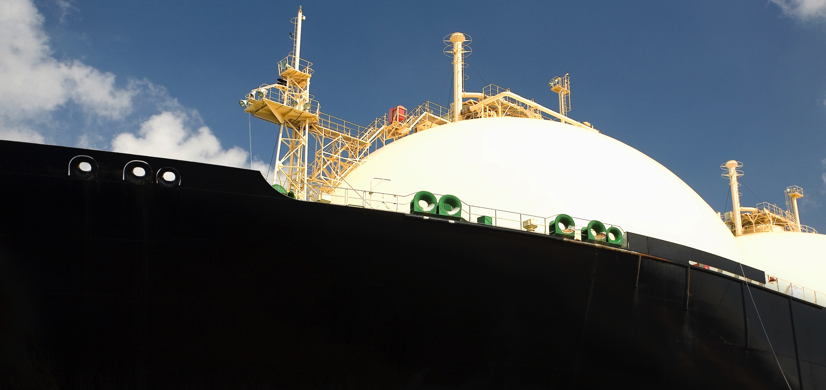
LNG FUEL REMOVES REGULATORY UNCERTAINTY
LNG fuel is the lowest carbon fossil fuel and can support ship owners and operators in meeting the current and future expected IMO Marpol Annex VI sulphur and nitrogen oxide emission limits.
LNG offers:
Virtually zero SOx emissions
Significantly reduced particulate matter
Significantly reduced NOx

Slide 6
POTENTIAL DEMAND UPSIDE FROM TRANSPORT SECTOR
LNG imports (MTPA)
MTPA equivalent, 2025
Other LNG Demand
LNG Bunkering Demand
Source: Shell interpretation of Wood Mackenzie and IHS

Slide 7
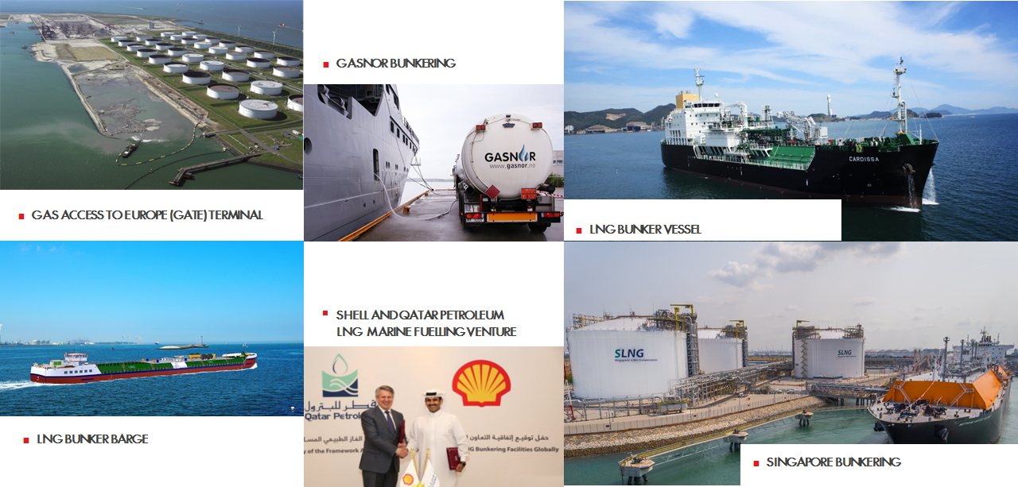
SHELL’S MARINE SUPPLY INFRASTRUCTURE

Slide 8
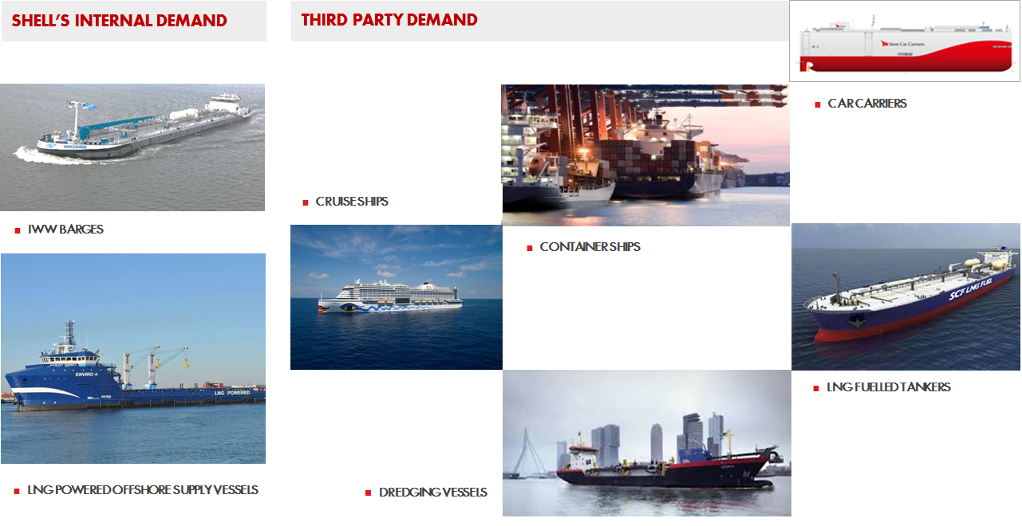
SHELL’S MARINE LNG DEMAND

Slide 9
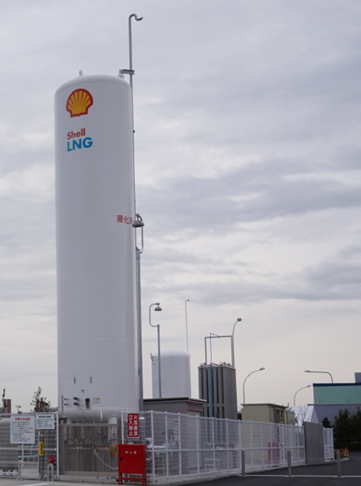
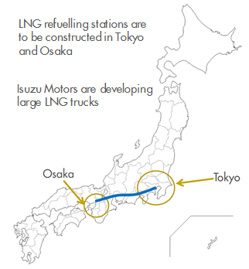
TOKYO SITE (KEIHIN TRUCK TERMINAL)

